Slide 1
APA Documentation

Slide 2
Goals for Today
Examine APA in-text documentation
Discuss general APA format
Practice reference formatting

Slide 3
Bringing in Other Authors
In academic writing, you have to establish for your readers what has been said, who said it, and (in APA style) when it was said before contributing to the “conversation.”

Slide 4
APA Style
American Psychological Association
Originally designed for psychology and social sciences, extended to other fields
Emphasizes authors and dates, which must be given in the body of your text
Notes:
APA is named for the American Psychological Association, the body that originated the APA style.

Slide 5
To Cite (verb)
To identify the source of statements derived from another work you have read (a.k.a. to document).
This identification is done in the text through signal phrases and parenthetical citations in APA style.
Notes:
To make sure we’re all together, I want to cover some key vocabulary here and in the next few slides.

Slide 6
What to Cite
Cite any information you have read which has an effect on your paper (American Psychological Association, 2010).
Direct Quotations
Borrowed Ideas
Notes:
If you read something, saw a video, or heard a lecture—whatever the medium—and it has led you to want to write about it in your paper, then it is having “an effect on your paper” and needs to be cited in your text.

Slide 7
Why Cite?
Academic honesty—
Show respect for other authors by identifying them when you borrow their ideas or words.

Slide 8
Avoid Plagiarism
According to Diana Hacker and Nancy Sommers (2011), “Three different acts are considered plagiarism: (1) failing to cite quotations and borrowed ideas, (2) failing to enclose borrowed language in quotation marks, and (3) failing to put summaries and paraphrases in your own words” (428).

Slide 9
Instead . . .
Cite your sources!
Notes:
Instead of plagiarism, we cite our sources—using in-text citations!

Slide 10
Citing Quotations
Direct quotes—exact word-for-word copies of the original text in quotation marks

Slide 11
Example of APA Quotation
Hence, as Baumeister (2005) put it, “the human self has to seek both common ground with others (to gain acceptance) and distinctive capabilities (to perform a unique role within the system)” (p. 45).
(Gebauer et al., 2014, p. 454)

Slide 12
Citing Borrowed Ideas
Borrowed ideas = using others’ work
Summary—short version of a text in all new words
Paraphrase—also completely rewords and restructures a text, but is about the same length as the original
When in doubt, cite the source.
Notes:
Some more key vocabulary here: if you are writing about “statistics and other specific facts; visuals such as cartoons, graphs, and diagrams; and any ideas you present in a summary or paraphrase” they are borrowed ideas that need to be cited (Hacker, 2011, p. 500).

Slide 13
In-Text Citations
When using information from another work, it should be identified by a signal phrase leading into the sourced material, followed by a parenthetical citation when needed (Hacker & Sommers, 2011).
Notes:
When using sources, there are four key elements. The first three are the signal phrase, the sourced material, and the parenthetical citation.

Slide 14
APA Signal Phrases
Identify the author(s), then give the publication year in parentheses, and generally introduce the origins of the information.
Notes:
We use signal phrases to avoid what have been called “dumped quotes.”

Slide 15
No Dumped Quotes!
A quotation without a signal phrase, citation, or discussion is called a “dumped quote.”
Dumped quotes lack credibility and do not flow well.

Slide 16
Example of Dumped Quote
Some authors talk about language in a descriptive way and others are prescriptive. “Before the eighteenth century, writers and speakers typically referred to an indefinite subject . . . with a they, their, or them.” Lynne Truss likes to tell people where to put their commas.

Slide 17
Huh?
Who said what? Which? When?
Where was the quote from?
Who is Lynne Truss?

Slide 18
Example of Improved Quote
Authors are generally of two minds about language, either descriptive or prescriptive. Ben Yagoda (2007), professor of English and journalism at the University of Delaware, argues that people should be able to use “they” for singular indefinite subjects, and demonstrates with examples that span centuries (p. 184). Because there is so much evidence of its accepted use, he doesn’t think there should be a rule against it. [continue]

Slide 19
Example of Improved Quote cont’d
In contrast to Yagoda’s descriptive approach, Lynne Truss (2004), author of Eats, Shoots and Leaves, demands that “‘Sticklers unite!’” to enforce British punctuation rules (p. xviii). She believes “standards of punctuation are abysmal” in the UK and US, and her book dictates how English should be written (p. xviii). However, she mistakenly equates punctuation rules with grammar (p. xix), causing one to doubt her reliability.
Notes:
We want to anticipate what our readers will need to know in order to understand our sourced material. We do this by providing clear context and documentation.

Slide 20
Signal Phrases
Mark where your words end and the ideas of another writer begin—regardless whether it is quotation, summary, or paraphrase.

Slide 21
First, Introduce Your Friends
Give the author’s full name and credentials the first time mentioned.
Later citations, only family name.
Notes:
If there are many authors to a given work, give the lead author’s name and refer to the other authors more generically in the APA style.

Slide 22
Example Author Credentials
The team of researchers at the University of Washington Medical School led by Dr. Maxine Moynihan (2013) determined that . . .
Ben Yagoda (2007), professor of English at the University of Delaware, has delighted in . . .
Notes:
There might have been seven authors credited on the Moynihan research, but here they are referred to generically as the “team of researchers.”

Slide 23
Next, Action!
Use past tense or present perfect tense verbs and show how you are using the source material in relation to your thesis or purpose.
Background
Support
Refutation

Slide 24
APA Verb Tense
Present tense is to be used only when “discussing the results of an experiment (the results show) or knowledge that has clearly been established (researchers agree)” (Hacker & Sommers, 2011, p. 506).

Slide 25
APA Signal Phrase Formats
Author (YEAR) verbed/has verbed . . .
or
“ . . .” verbed Author (YEAR, p. ##).
or
[According to] Author (YEAR), “ . . .” (p. #).

Slide 26
Example Signal Phrases
Burns, Quimby, and Simpson (2012) devised a metric whereby . . .
“. . .,” as Dawkins explained (1999, p. 76).
This was seen as Smith et al. (1997) demonstrated in the synthesis of . . .

Slide 27
Citations for Summaries
In a literature review, almost all the support of your argument will come from others’ work and must have author-date citations, even for brief analyses of many sides of a debate.

Slide 28
Example of Summary Analysis:
While some linguists have reduced language to an unrecognizable mathematical abstraction (Chomsky, 1957), others who write about language have done so, not in the voice of dry academic researchers, but with passionate nostalgia (Truss, 2004).

Slide 29
Quotations
In the APA style, most quotations are short phrases blended into sentences.

Slide 30
Example Blended Quotation
Usability indicates that a user can accomplish a task “quickly and easily” (Nielson, 2005); it is considered “user-friendly.”
(Dennison, 2011, p. 43)

Slide 31
Parenthetical Citations
A parenthetical citation is the documentation given in parentheses at the end of a sentence or a natural clause break.
Give page numbers when pagination is always the same: print and PDFs.

Slide 32
APA Parenthetical Citations
If a traditional APA signal phrase is not used, then the author’s name and publication date must be in the parenthetical citation.

Slide 33
Example of Parenthetical
As a result, the situationist perspective dominated psychological thinking almost entirely until the 1980s (Penner et al., 1995).
(Example from Gebauer et al., 2014, p. 453)

Slide 34
Follow a Quote with Your Point
In addition to the signal phrase and verb choice, give further explanation to connect a quote or summary to your own thesis argument:
Notes:
The fourth key element to using quotations is the follow-up that discusses the quote’s ideas.

Slide 35
Example of Following with Your Point
argument intro
Generally, Yagoda (2007) takes the middle ground in the debate on the English language. With the curious eye of a linguist, he gathers examples of usage from respected academic journals, literary canon, as well as popular culture to identify what is acceptable by users of the language. However, like a traditional grammarian, he also applies his own rigid notions about pronouns when answering the phone: “I think ‘This is he’ sounds pompous but ‘This is him’ sounds louche [disreputable]” (p. 191). His personal views underscore just how emotional academics can be about grammar—a supposedly objective, rule-based subject.
the point
Notes:
You should open a paragraph with your own thesis-supporting topic sentence and lead into the material from sources, then follow up with the point you want to make via the source material.

Slide 36
After a Quote
Show what you want readers to understand about the quote.
Have you quoted statistics? Then show what those stats mean for your argument.
An author’s findings have a certain effect? Explain why that matters according to your thesis.
Notes:
A quote can’t just speak for itself—you have to tell readers what you want them to get from the quote.

Slide 37
Example Significance of a Statistic
Researchers have found that extreme stress triggers a physiological response unique to each individual and that what manifests in one person immediately can take “up to two years to appear in 8% of the general population” (Howard p. 465). This indicates that some patients won’t begin suffering from a trauma until years later. Because physical reactions to stress can take a very long time to emerge, clinicians need to take a detailed history that goes back two or more years to find patterns of stressors and symptoms.
Notes:
The quote is followed by first, an explanatory sentence (in the solid outline), then next, the writer’s analysis of the significance of this information (in the dotted outline).

Slide 38
Elements of APA Documents
Title Page
Running Header
Abstract
Document Sections with Headings:
Introduction
Method
Results
Discussion
References
Notes:
Now that we’ve gone over the content style, let’s look at the document format. This is the overview of the following slides. You can also follow along in your handouts.

Slide 39
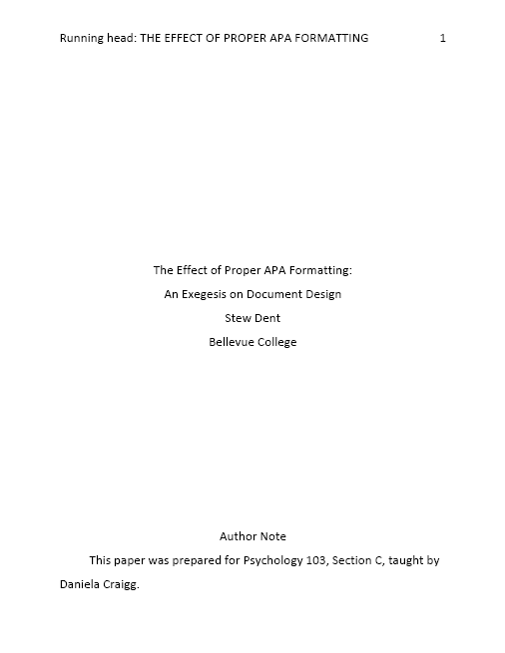
APA Title Page

Slide 40
Title Page
Header aligned left:
Running head: SHORT VERSION OF YOUR TITLE Maximum 50 characters in all caps
Page number aligned right
Notes:
In Microsoft Word, you can use the default tab settings in the header to right align the page number. Google Docs and Word for Macintosh users, your experiences may vary. Does anybody have laptops with them? We could walk through this together.

Slide 41
Running Header
Use “Different First Page” function, and for title page only, type “Running head:” before a truncated version of your title in ALL CAPS.
In rest of document, header is only your title in all caps.
Throughout document, page numbers should align with the right margin starting from the title page.

Slide 42
Title Page cont’d
Middle of page, centered:
Full title of your work (12 words or fewer)
Your name
Your school’s name
Near bottom of page:
Heading “Author Note” centered
First line indented ½-inch
The course name, section, and instructor name, or other institutional information

Slide 43
Abstract
Summary of your document, 100-150 wds
Format:
Center heading “Abstract” top of page 2
Begin abstract paragraph without indenting the first line.
Double space throughout.

Slide 44
Document Body
Begin with full title centered on pg 3
12-pt Times New Roman/Arial/Calibri
Indent first lines of paragraphs one half-inch
Double space throughout
No extra space between paragraphs

Slide 45
Section Headings
Centered and boldface type
Capitalize the first letter of the first and last words, and all words of 4 letters or more
Typical sections include introduction, method, results, and discussion

Slide 46
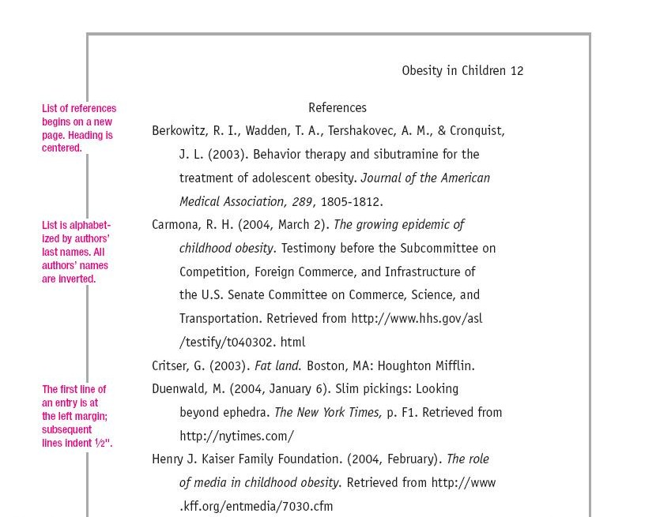
List of References
SHORTENED TITLE WOULD BE HERE
Figure 1. Example of References Retrieved from http://dianahacker.com/pdfs/Hacker-Mira-APA.pdf

Slide 47
References Format
Begin on new page after conclusion
Center heading “References”
List works referred to in document

Slide 48
References Format cont’d
Alphabetize list by lead author’s family name, in order given in original
Name all the authors for each source in the order “family name, initials”
Maintain double-spacing throughout
Use ½-inch hanging indent

Slide 49
Five General Types of Sources:
1. Book:
Author, Initial. (YEAR). Title in italics: With only the first word of title and subtitle capitalized. City: Publisher.
2. Chapter in an edited book:
Author, I. (YEAR). Title of Chapter. In Q. Lastname (Ed.), Title of the book (pp. X-XX). City: Publisher.

Slide 50
3. A journal article from a database:
Author, I. (YEAR). Article title: And subtitle if any. Periodical Title, Volume number(issue #), page range. doi: 10... OR Retrieved from and the name of the database or URL of publication homepage.
For magazine/newspaper articles, (YEAR, Month ##)—Full name of month
For DOI, no period at end of entry.

Slide 51
4. An online article:
Author, I. & Author, I. M. (YEAR, Month). Title of the work: And subtitle if one. Retrieved from URL.

Slide 52
5. Article in a print periodical:
Author, I. (YEAR, Month). Article title: Subtitle if any. Periodical Title, Volume #(Issue#), page range #-##.

Slide 53
Practice Reference Entries
Agency-Communion and Interest in Prosocial Behavior: Social Motives for Assimilation and Contrast Explain Sociocultural Inconsistencies—database article with a DOI
http://web.a.ebscohost.com/ehost/detail/detail?vid=3&sid=282ba211-4222-4e1a-92cd-346c6427da9b%40sessionmgr4004&hid=4206&bdata=JnNpdGU9ZWhvc3QtbGl2ZQ%3d%3d#AN=97983194&db=a9h
From Assimilation to Accommodation: A Developmental Framework for Integrating Digital Technologies into Literacy Research and Instruction—database article without a DOI
http://web.a.ebscohost.com/ehost/detail/detail?vid=3&sid=acfbb53b-473b-4764-a566-dc273f186459%40sessionmgr4005&hid=4206&bdata=JnNpdGU9ZWhvc3QtbGl2ZQ%3d%3d#db=a9h&AN=10452922

Slide 54
References
American Psychological Association. (2010). Publication manual of the American Psychological Association. 6th ed. Washington, D.C.: American Psychological Association.
Cranwell-Bruce, L.A. (2010, January-February). Drugs for Alzheimer’s disease. MEDSURG Nursing, 19(1), 51-53. Retrieved from EBSCOhost Academic Search Complete database.
Dennison, H.A. (2011). Creating a computer-assisted learning module for the non-expert nephrology nurse. Nephrology Nursing Journal, 38(1), 41-53. Retrieved from EBSCOhost Academic Search Complete database.

Slide 55
Further References
Gebauer, J. E., Sedikides C., Lüdtke O., & Neberich W. (2014) Agency-communion and interest in prosocial behavior: social motives for assimilation and contrast explain sociocultural inconsistencies. Journal of Personality, 82(5), 452-466. doi: 10.1111/jopy.12076
Hacker, D. & Sommers, N. (2011). A writer’s reference with exercises (7th ed). New York: Bedford/St. Martin’s.
Spatt, B. (2011). Writing from sources. New York: Bedford/St. Martin’s.

Slide 56
Even Further References
Truss, L. (2004). Eats, shoots and leaves: The zero tolerance approach to punctuation. New York: Gotham.
Yagoda, B. (2007). When you catch an adjective, kill it: The parts of speech, for better and/or worse. New York: Broadway.
Recommended Reading:
Graff, G. & Birkenstein, C. (2006). They say/I say: The moves that matter in academic writing. New York: W. W. Norton.

