Slide 1
Where the World
Comes Together to Learn

Slide 2
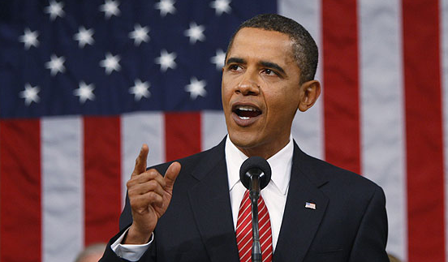
“With the changing economy, no one has lifetime employment.
But community colleges provide lifetime employability.”
- Barak Obama, President of United States of America

Slide 3
Community College V.S University
The terms, college and university, are used interchangeably and mean the same thing in the U.S.
As a general rule, colleges tend to be smaller and usually offer only undergraduate degrees, while a university also offers graduate degrees.

Slide 4
Community College Quick Facts
1,132 community colleges in the U.S.
Nearly 50% of undergraduates in the U.S. begin their studies at community colleges
8 million students in credit programs
5 million students in non-credit programs
43% Men; 57% Women
780,000 students are non-U.S. citizens
*American Association of Community Colleges, 2012

Slide 5
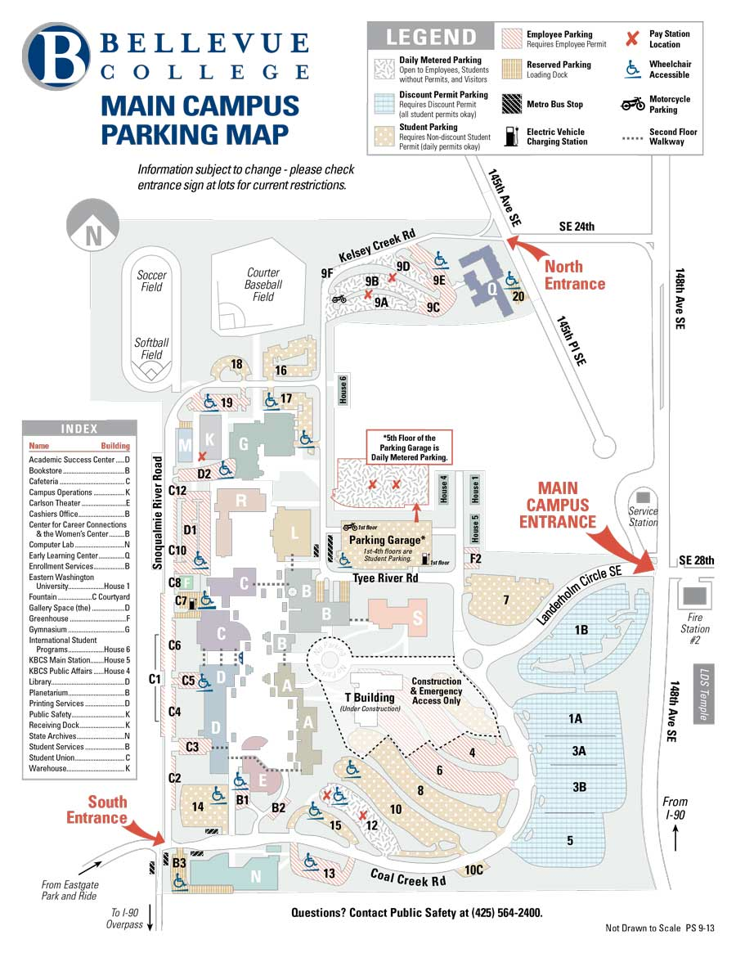
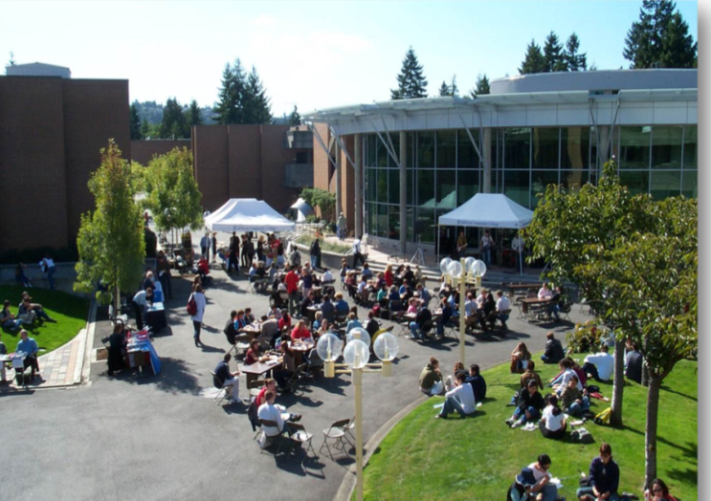
Bellevue College is the largest among the 34 community and technical colleges in State of Washington

Slide 6
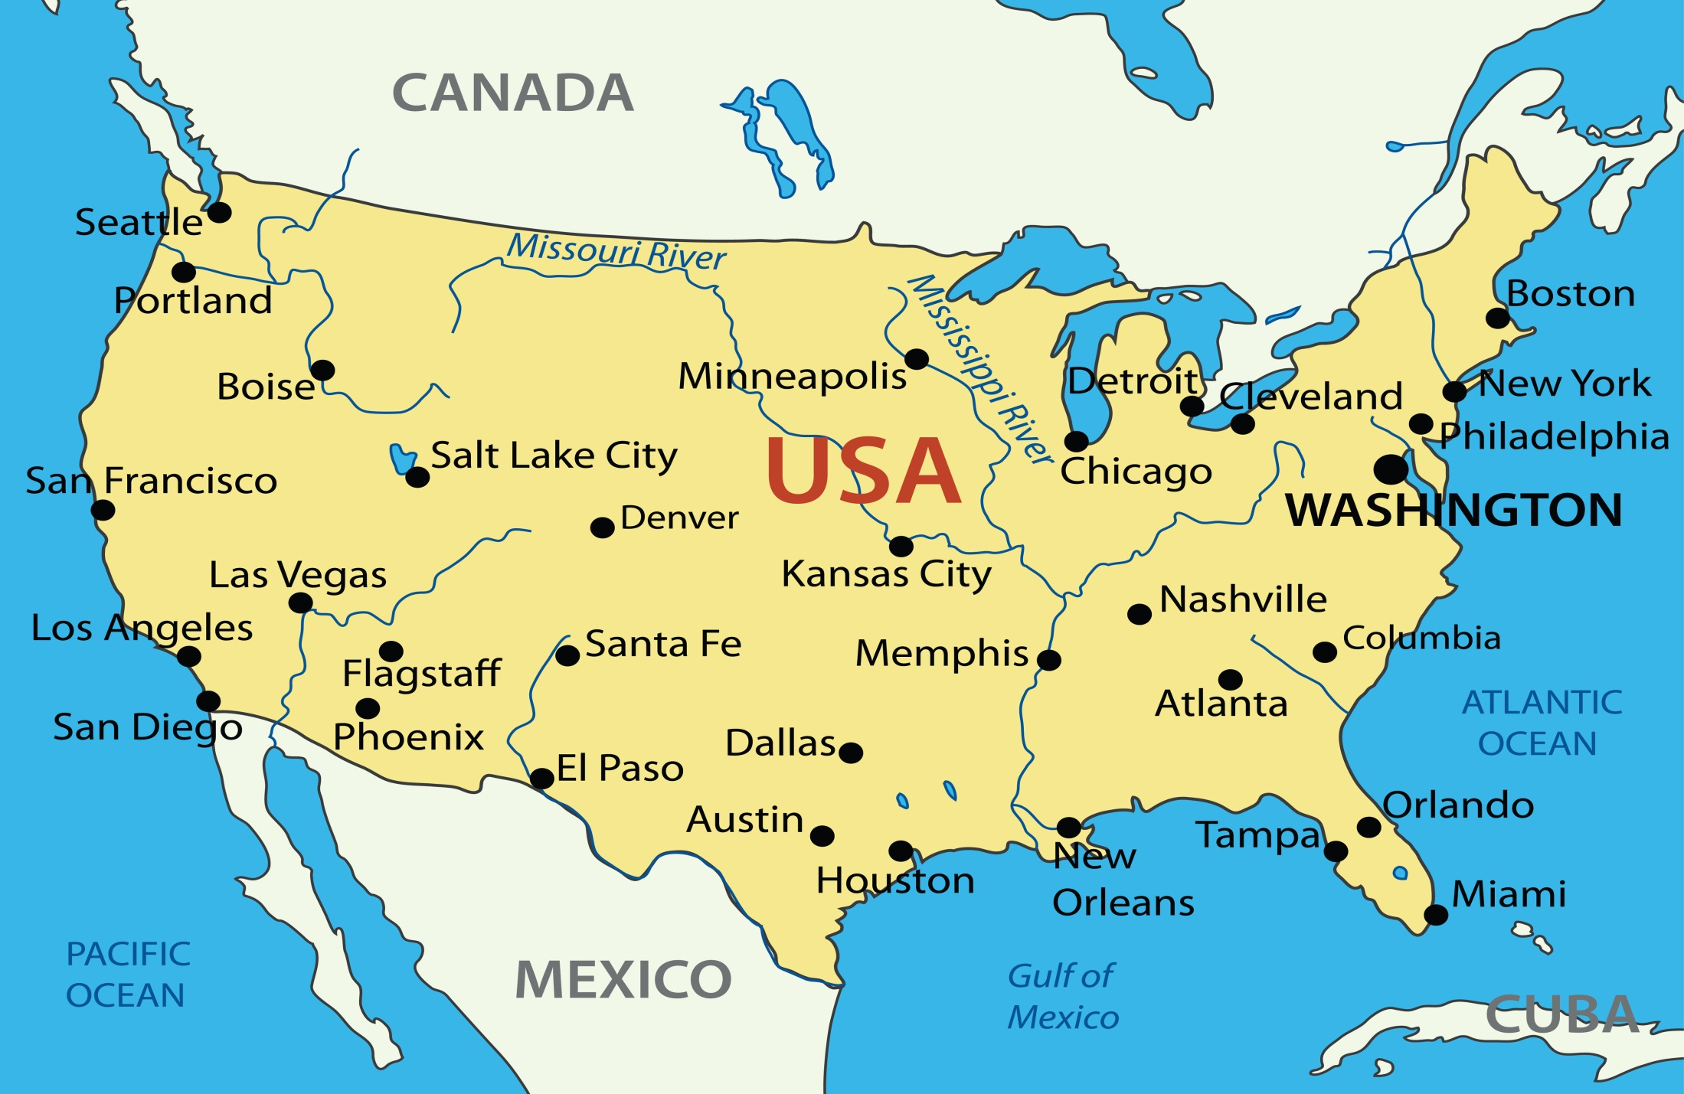
International Gateway to Destinations
Around the World
Notes:
SEATAC has non-stop flights to 20 cities around the world.
Beijing
Tokyo
Osaka
Seoul
Taipei
Victoria
Vancouver
Calgary
Edmonton
Toronto
Kelowna
Reykjavik
Los Cabos
Mazatlan
Puerto Vallarta
London
Amsterdam
Dubai
Frankfurt
Paris

Slide 7
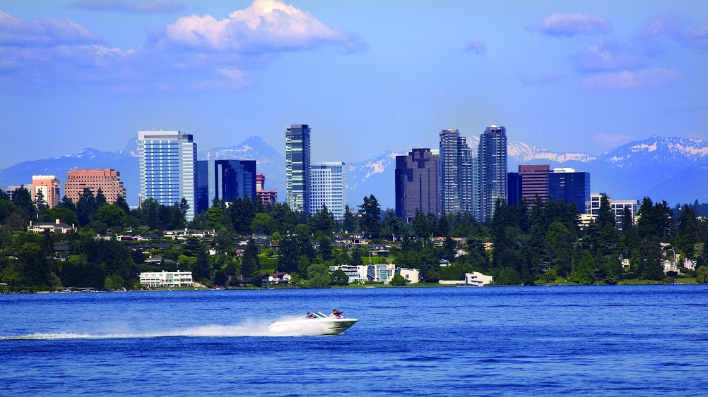
The City of Bellevue Advantage
A safe, clean, vibrant city fifteen minutes from Seattle downtown
Notes:
Population
Demograph

Slide 8
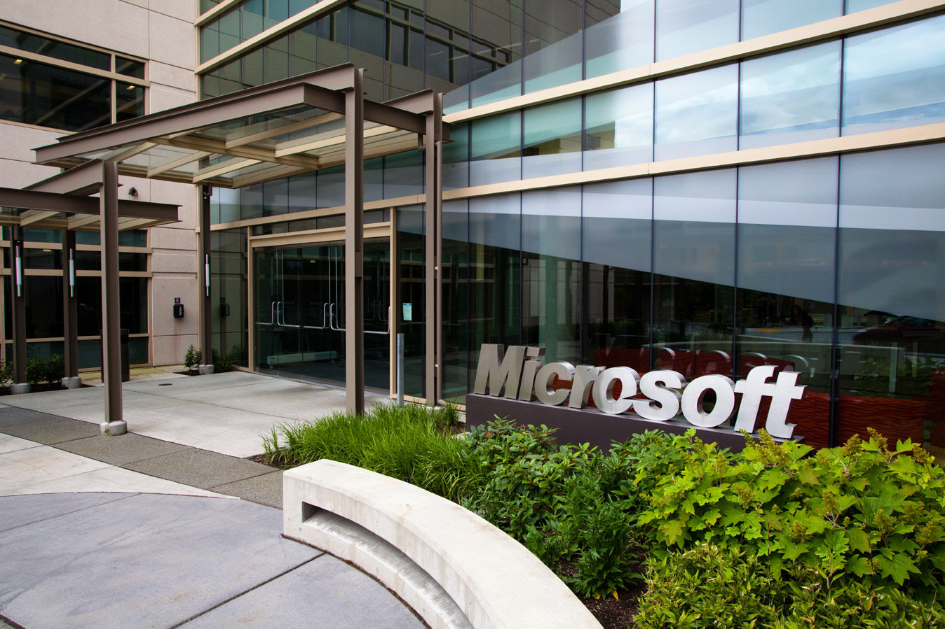
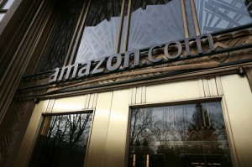
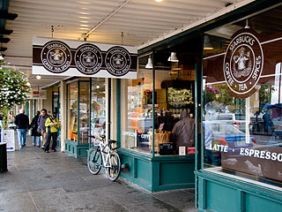
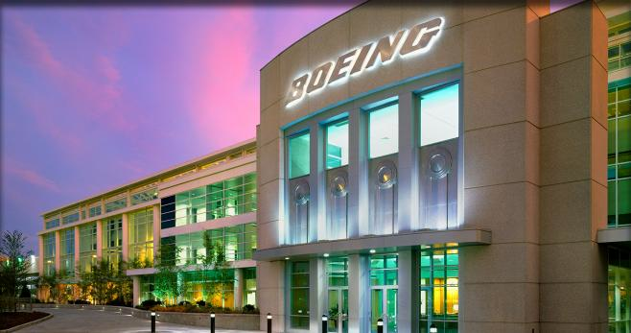
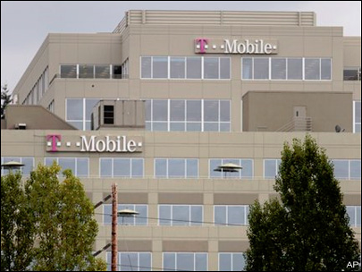
Proximity to the Many Great Companies

Slide 9
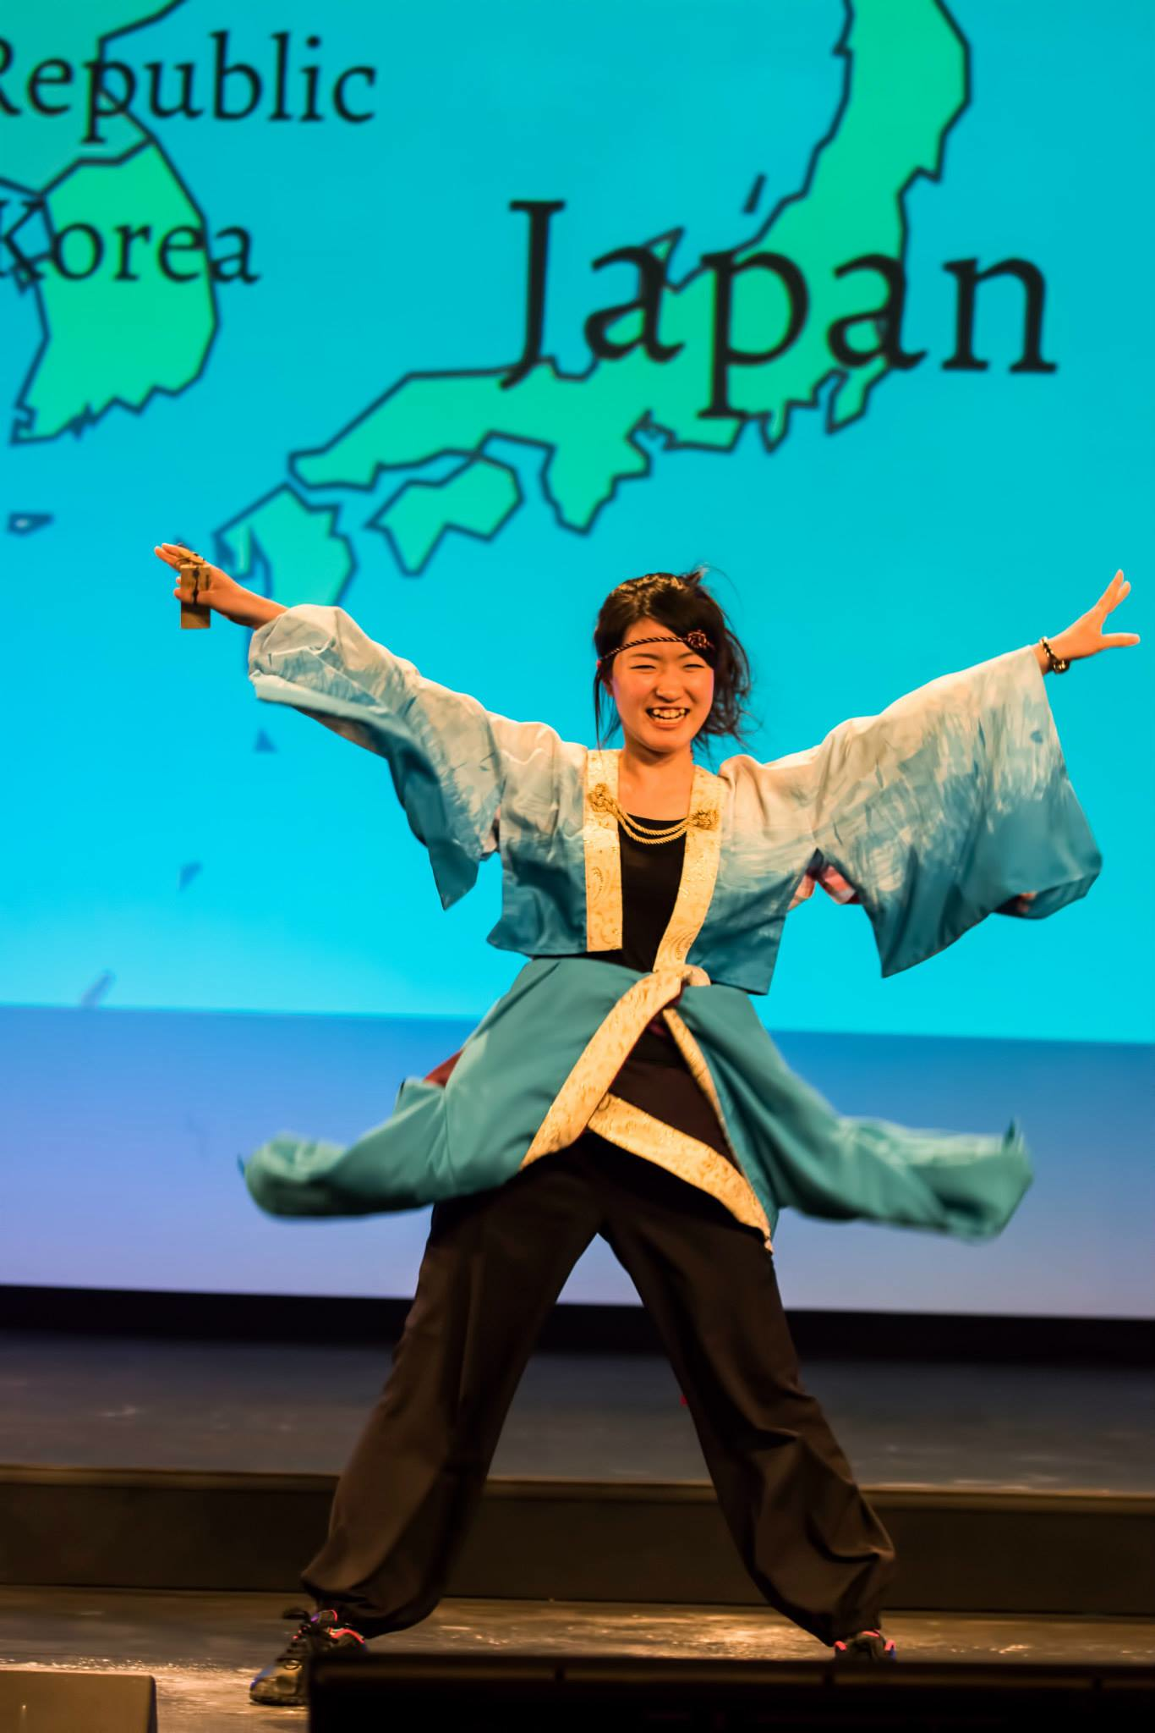
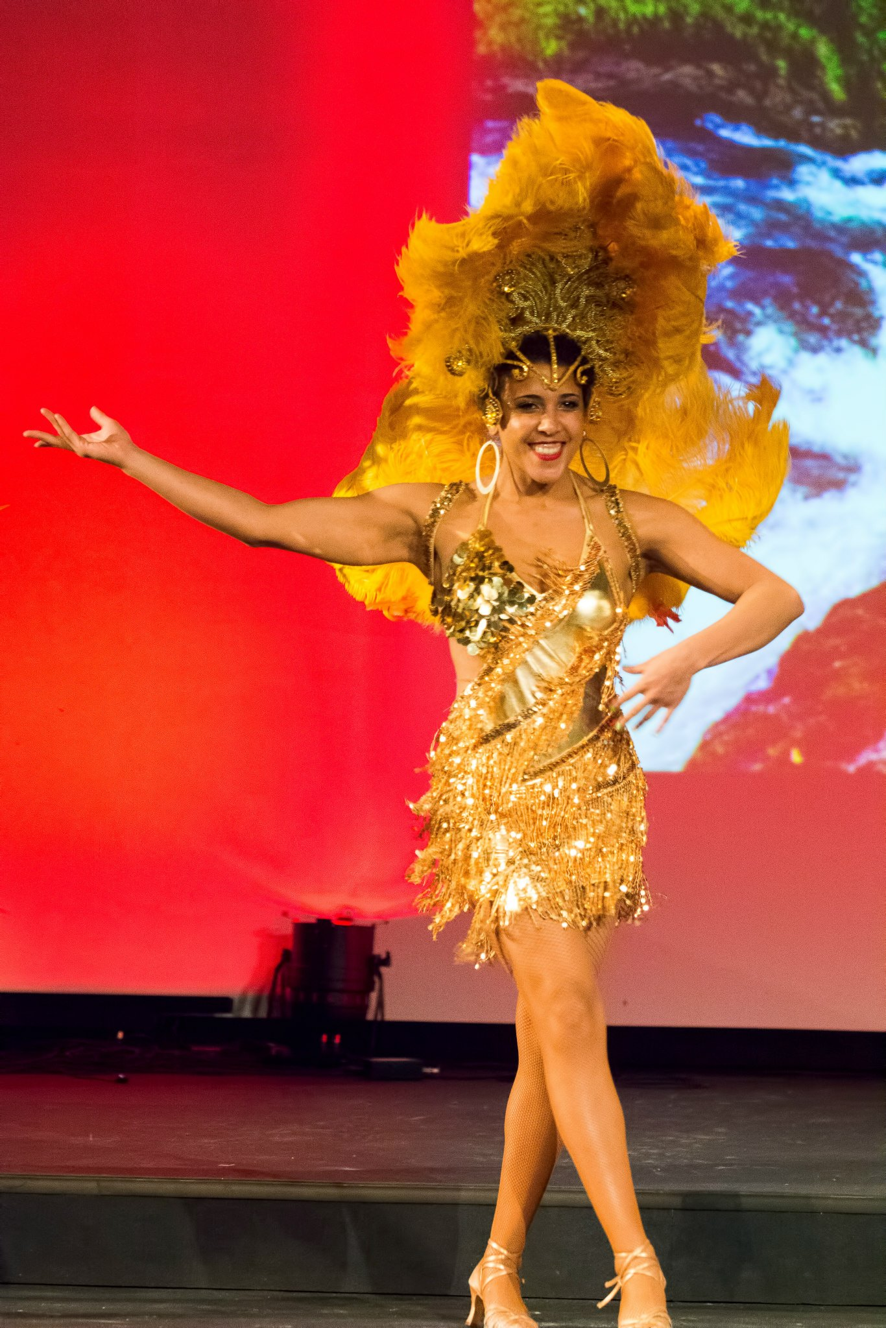
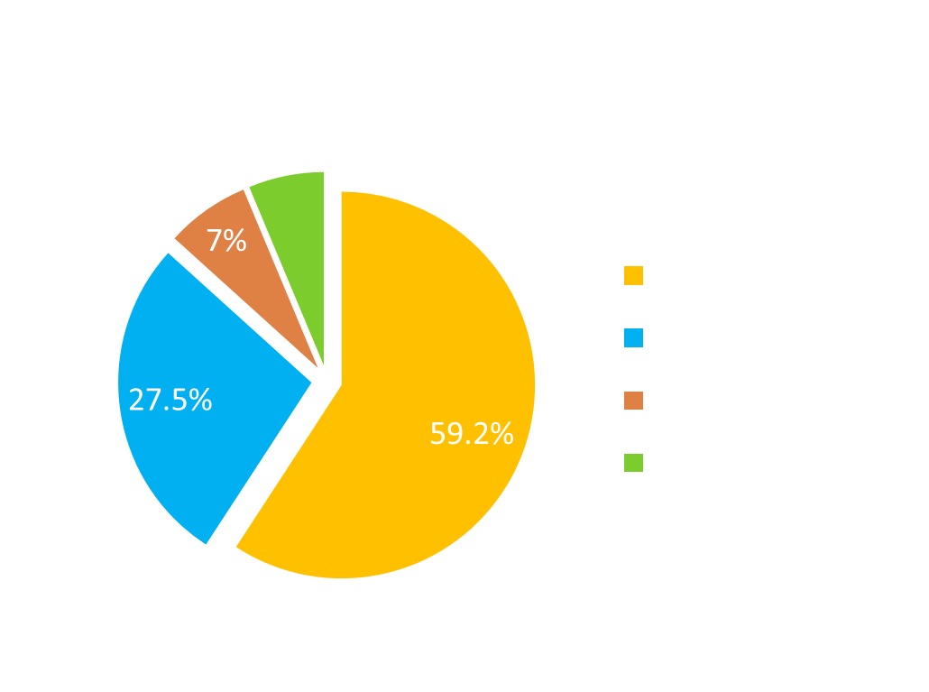
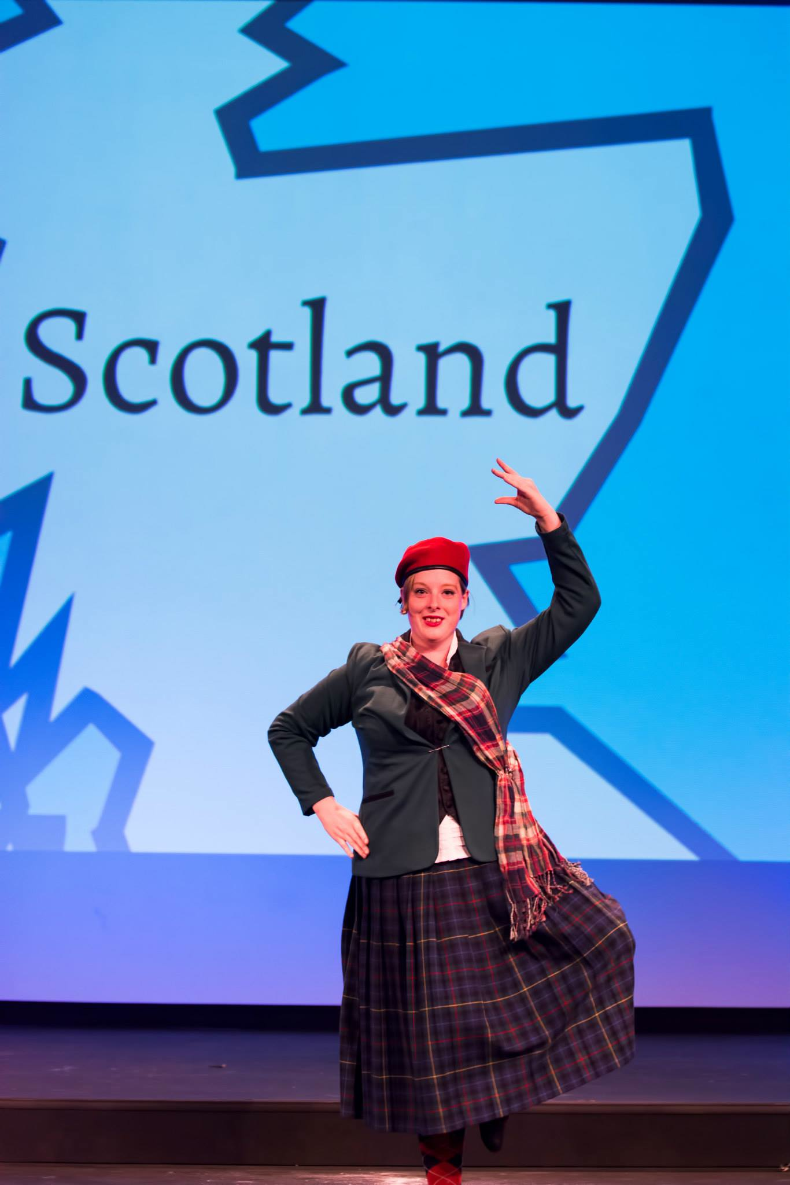
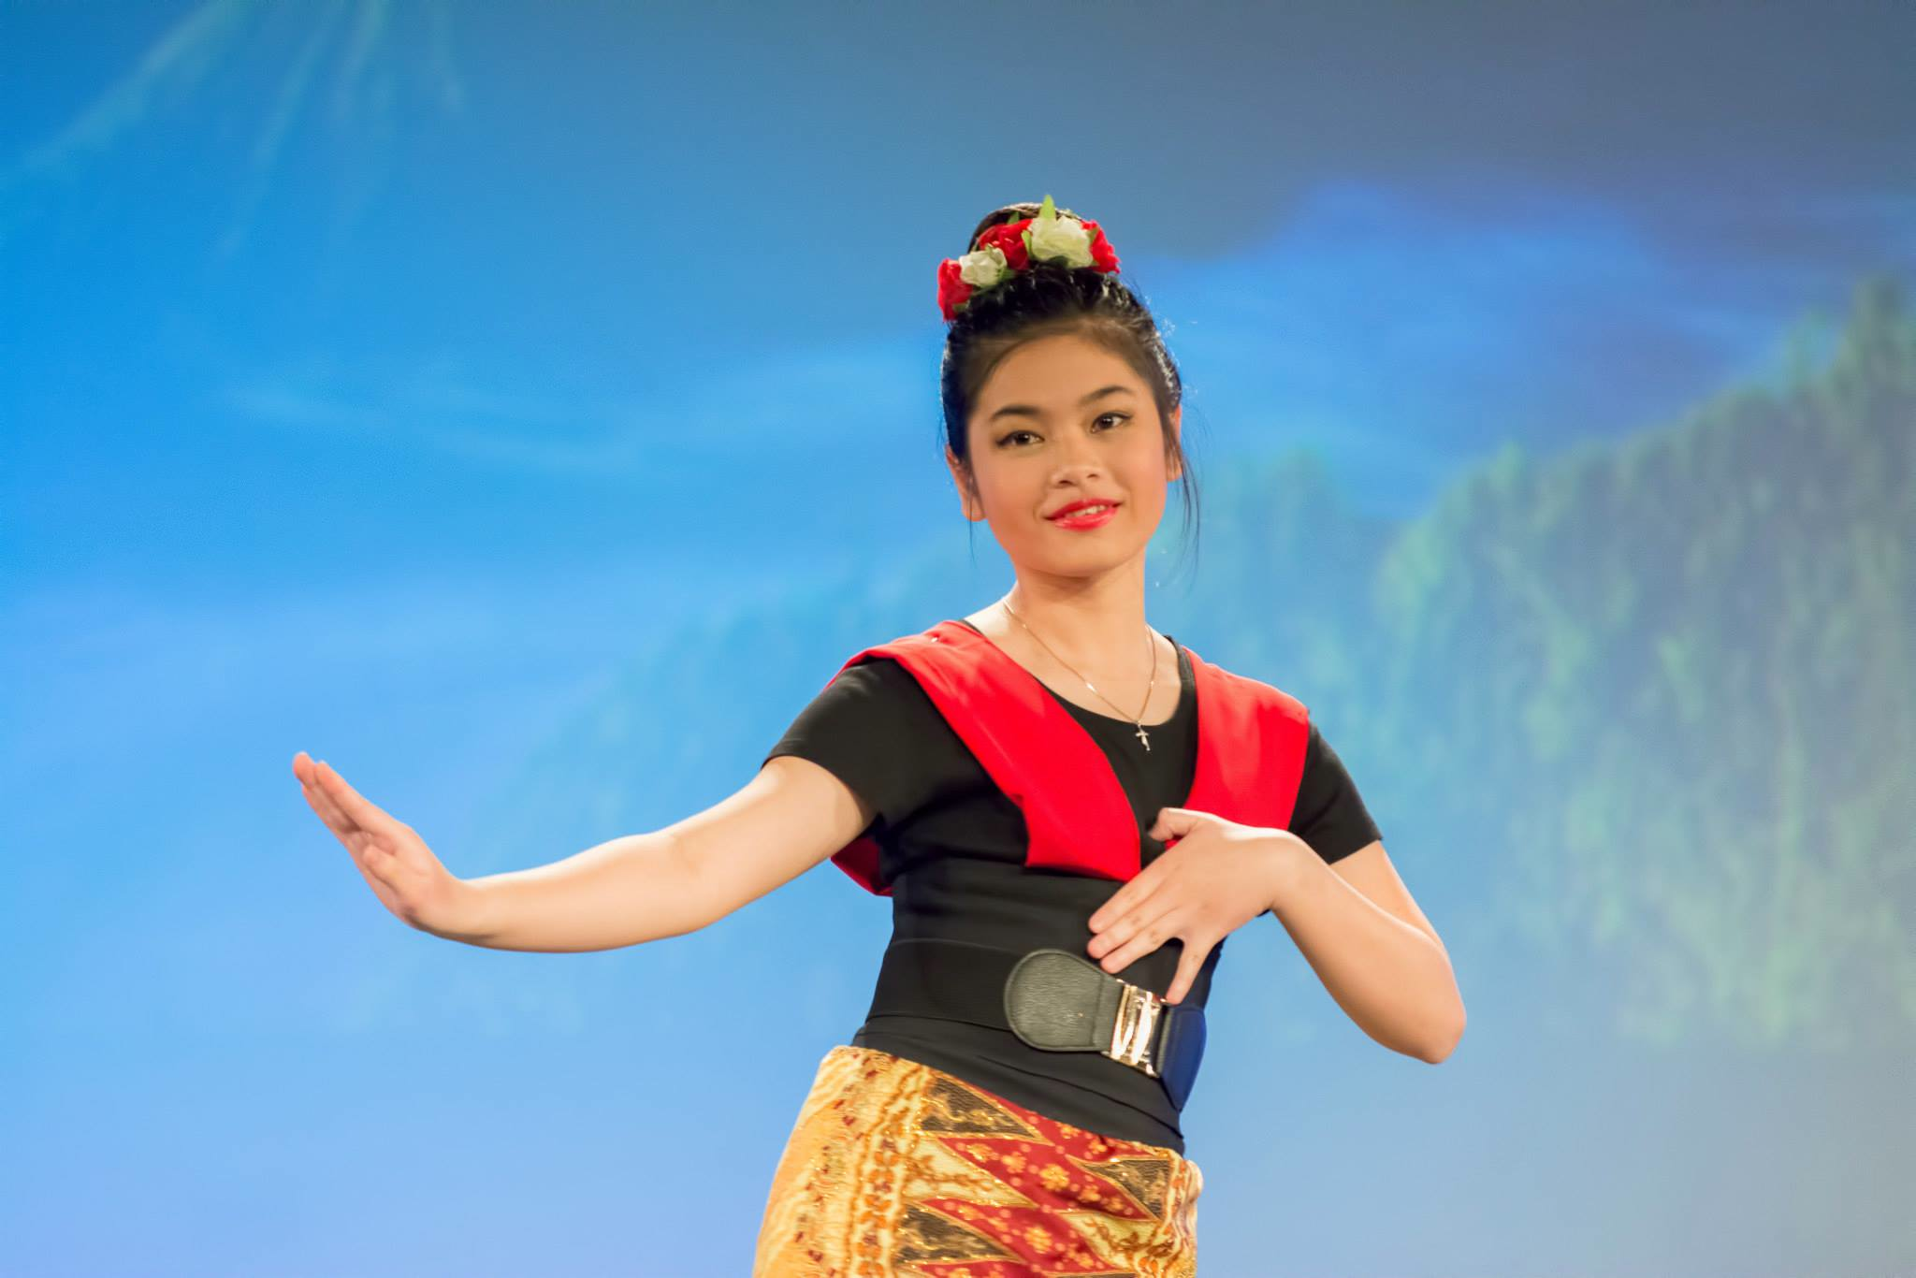
Bellevue City Advantage:
Culturally Diverse
* Source: City-Data.com, US Census Bureau

Slide 10
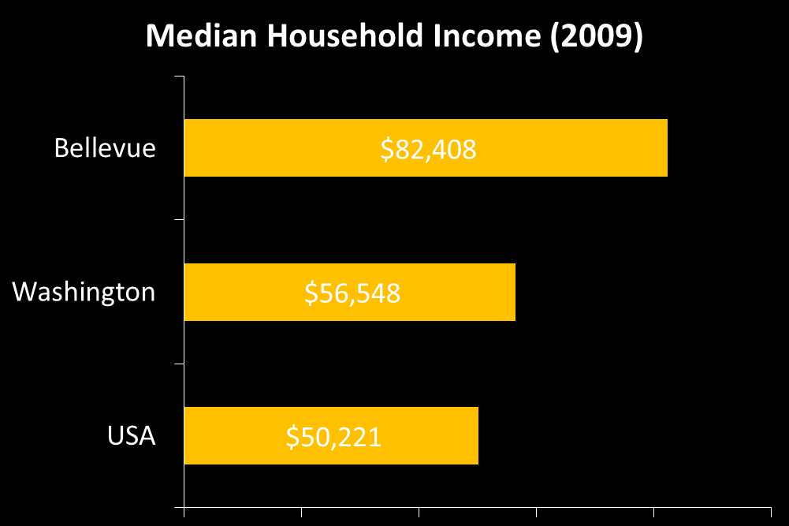
Bellevue City Advantage: Affluent Community
* Source: City-Data.com, US Census Bureau

Slide 11
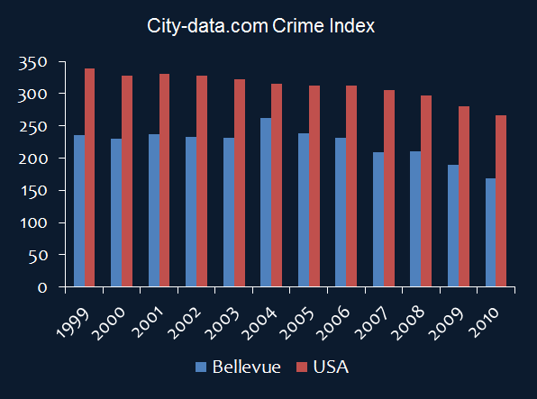
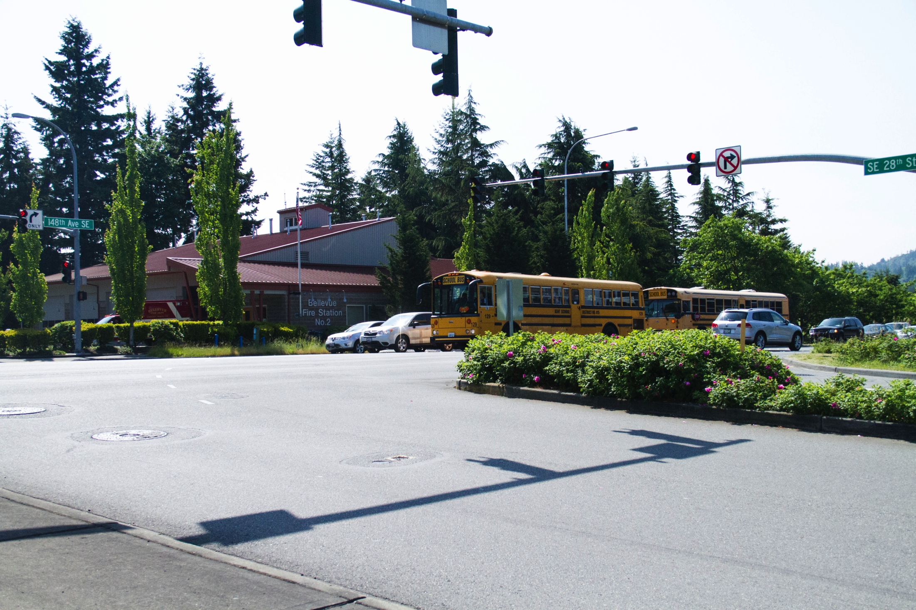
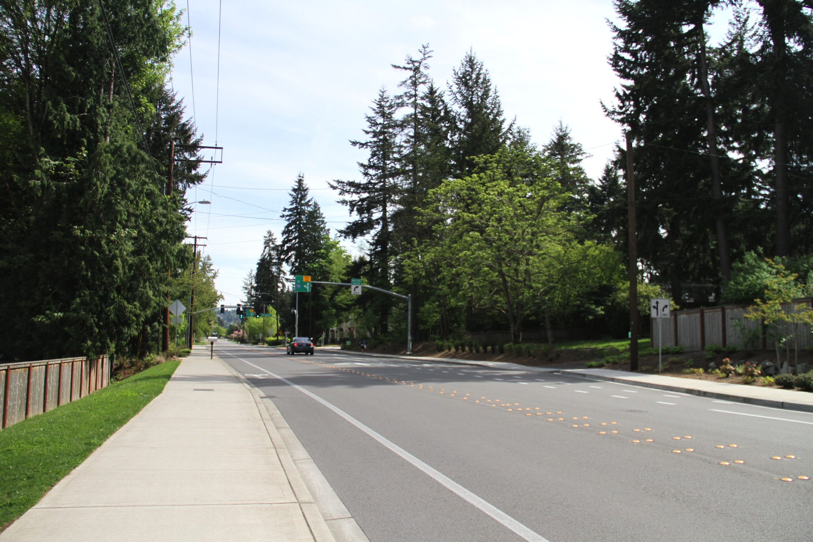
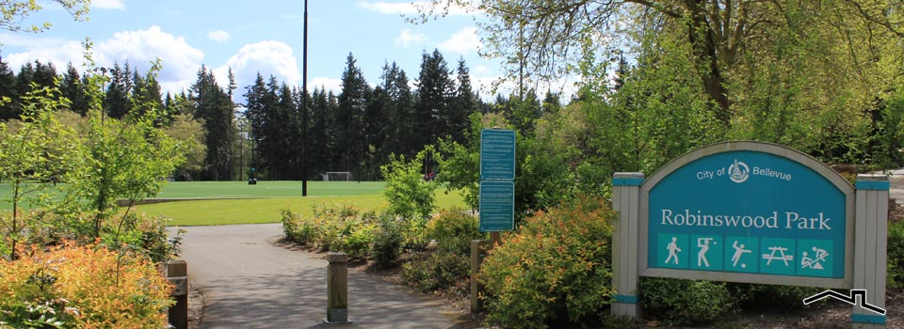
Bellevue City Advantage: Safe Neighborhood
* Source: City-Data.com, US Census Bureau

Slide 12
Bellevue City Advantage:
Well Educated Population
For population 25 and over in Bellevue:
High school or higher: 98%
Bachelor's degree or higher: 61%
Graduate or professional degree: 19%
* Source: City-Data.com, US Census Bureau

Slide 13
Our Network of University Connections
Bellevue College hosts two university transfer fairs each year

Slide 14
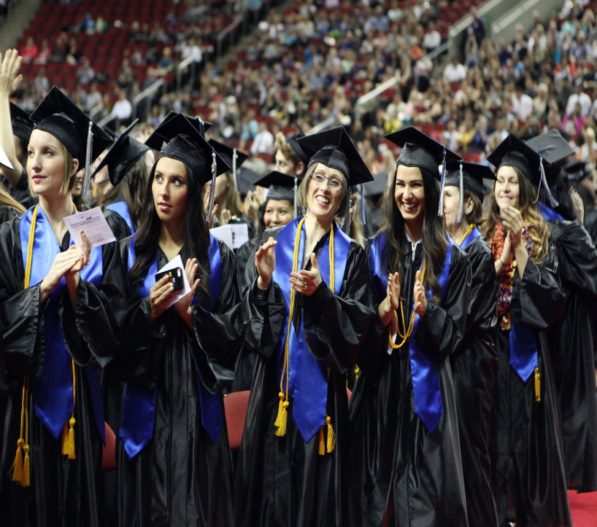
Our Software Advantage:
Commitment to Student Success
More students transfer to University of Washington than any other colleges in the state
High transfer rate to top universities throughout U.S.
60%+ international students graduate with honors
50% of our transferring International students in this past academic year went to top 50 universities in USA

Slide 15
Our Software Advantage:
Available Academic Options
Academic Options
Bachelor’s degree from Bellevue College and through EWU
University Transfer: Transferable two year study in 60+ academic fields
Over 75 professional/technical specialties
Intensive English for University Preparation
6-level program from beginner to advanced
Our highest levels provide a “bridge” between the program and academic studies

Slide 16
Our Software Advantage:
International Student Support
International Student Association
Meet other international students from around the world at weekly meetings
Academic Support Services
Writing and Reading Labs
Math Labs
Computer and Learning Labs
Basic Skills Lab
Library Media Center
Science Study Center
Academic Success Center

Slide 17
International Student Orientation
During orientation, new international students will:
Meet the International Student Programs staff
Take Math and English placement tests
Receive academic advising and register for classes
Attend seminars to help adjust to living and studying in the U.S.
Participate in fun social activities and make new friends
Take a tour around Seattle with other new international students

Slide 18
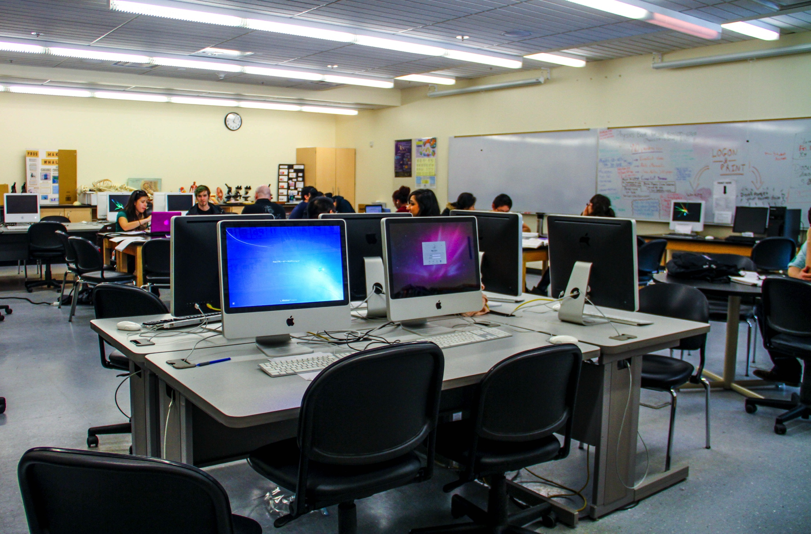
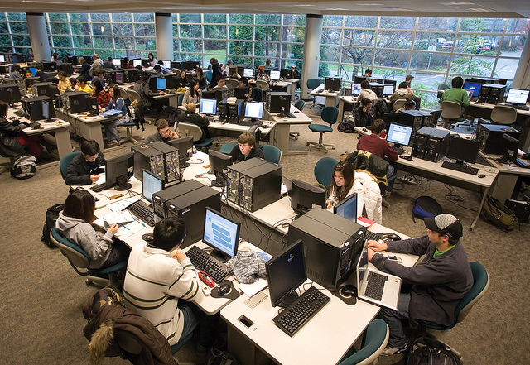
International Student Program Services
University transfer assistance
Academic planning and advising
Course selection and registration
Peer mentoring
Social, academic and cultural orientation
Immigration advising and assistance
Social activities
Scholarships
For both academic and leadership excellence

Slide 19
Some Clubs and Programs
Adv. Volleyball Club
Art Club
Associated Student Government
Badminton Club
BC Glee
Business Leadership
Club of Leaders
Chamber Music Club
Chess Club
Computer Science Club
Dance Productions
Fashion Club Bellevue College
International Talk Time
International Student Association
Piano Club
Photography Club
Ski and Ride Club
Soccer Club
Tennis Club
*More than 90 clubs and programs for students!

Slide 20
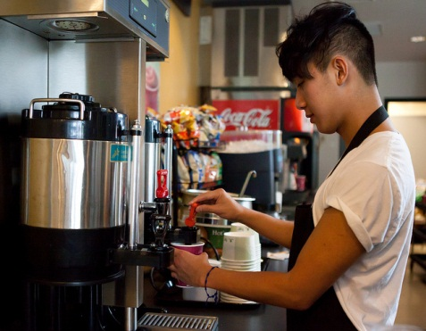
Other Services
On-campus Childcare
Working on Campus
Professional Counseling
Transfer Center
Career and Counseling Center
Internships and Volunteer Opportunities

Slide 21
Our Cost Advantage:
Excellent Value for Quality Education
ACADEMIC COSTS
Full-Time Tuition $9,234
Books and Supplies $1,026
Computer and other Fees $266
LIVING COSTS
Room & Board $9,492
Medical Insurance $864
Transportation: $1,296
Miscellaneous $1,794
TOTAL: $23,972
<Cost based on 15 credits, for 9 months>
Notes:
21

Slide 22
Bellevue College to University Transfer Program
Start at Bellevue College
Finish anywhere you want
Notes:
22

Slide 23
Our Cost Advantage: Savings for 2+2 Programs
4 Year Univ. of Washington
$184,372
Savings of
$48,610!
2 Year Bellevue College +
2 Year Univ. of Washington
$135,762
* Based on current cost of attendance estimate (2012)

Slide 24
Photo Gallery
&
Student Testimony

Slide 25
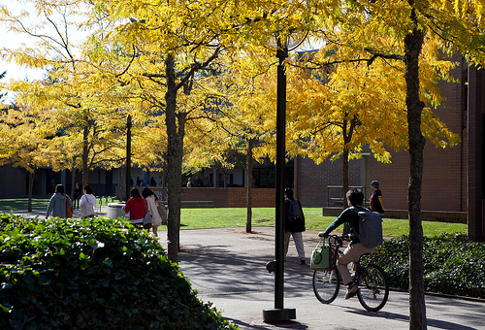
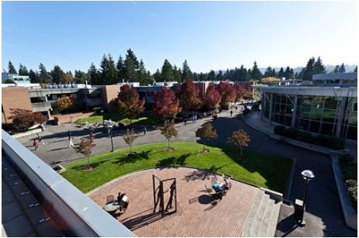
Bellevue College Campus

Slide 26
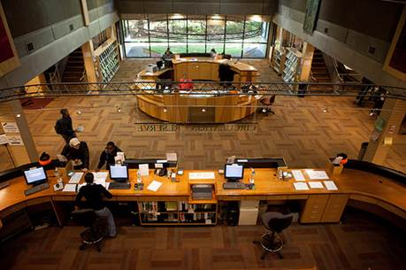
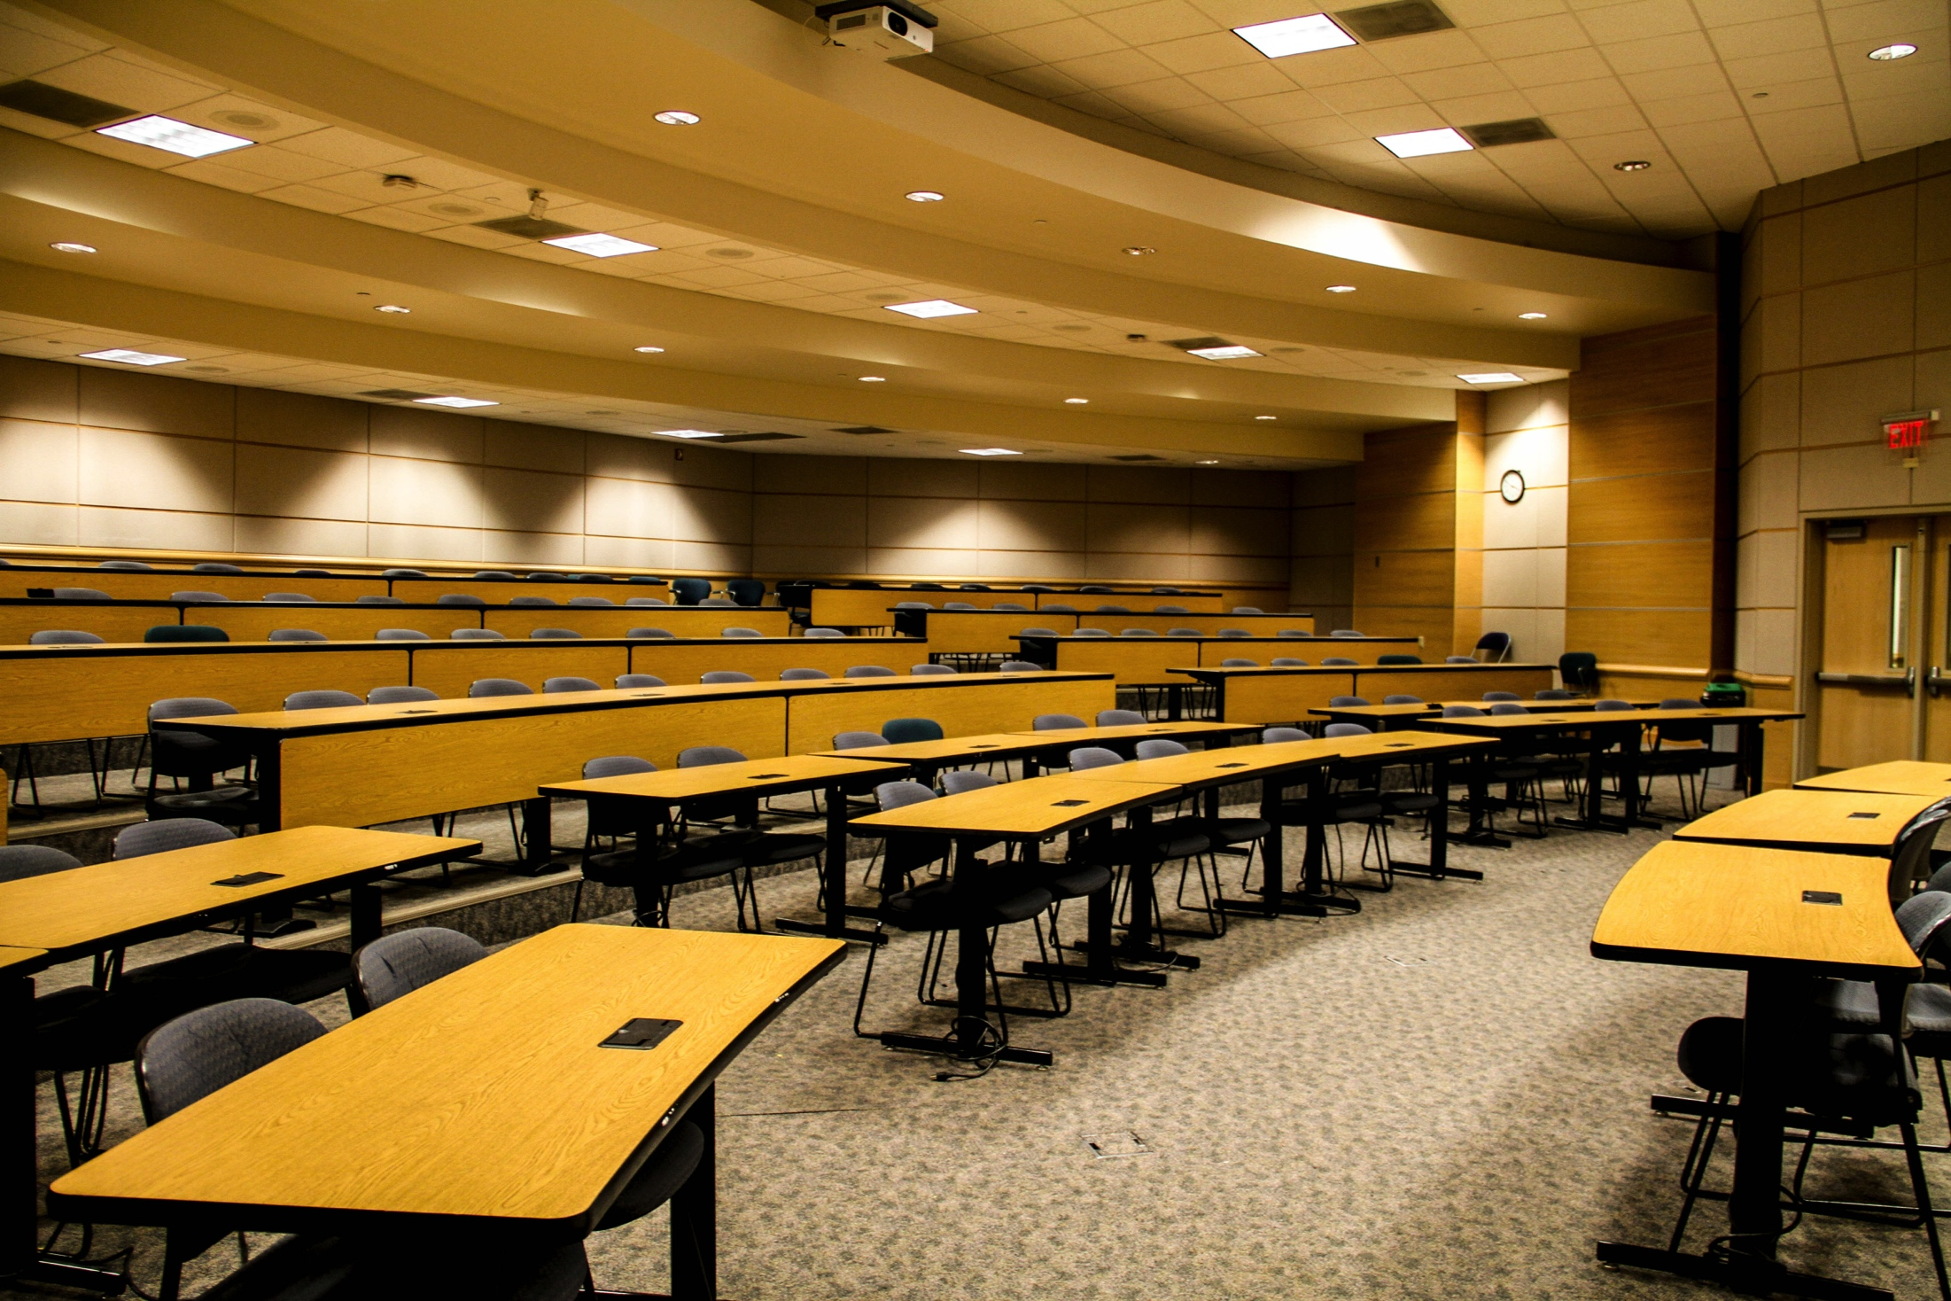
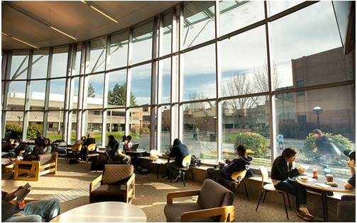
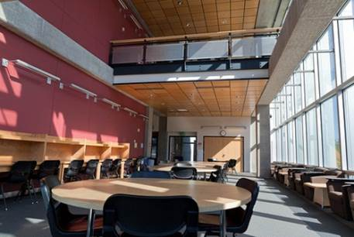
Bellevue College Campus

Slide 27
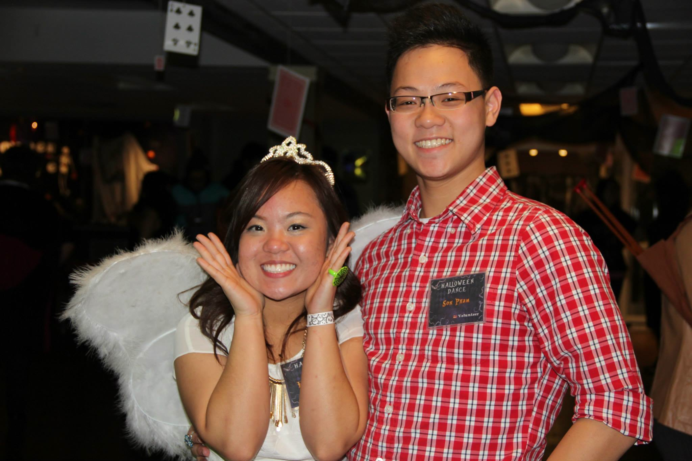
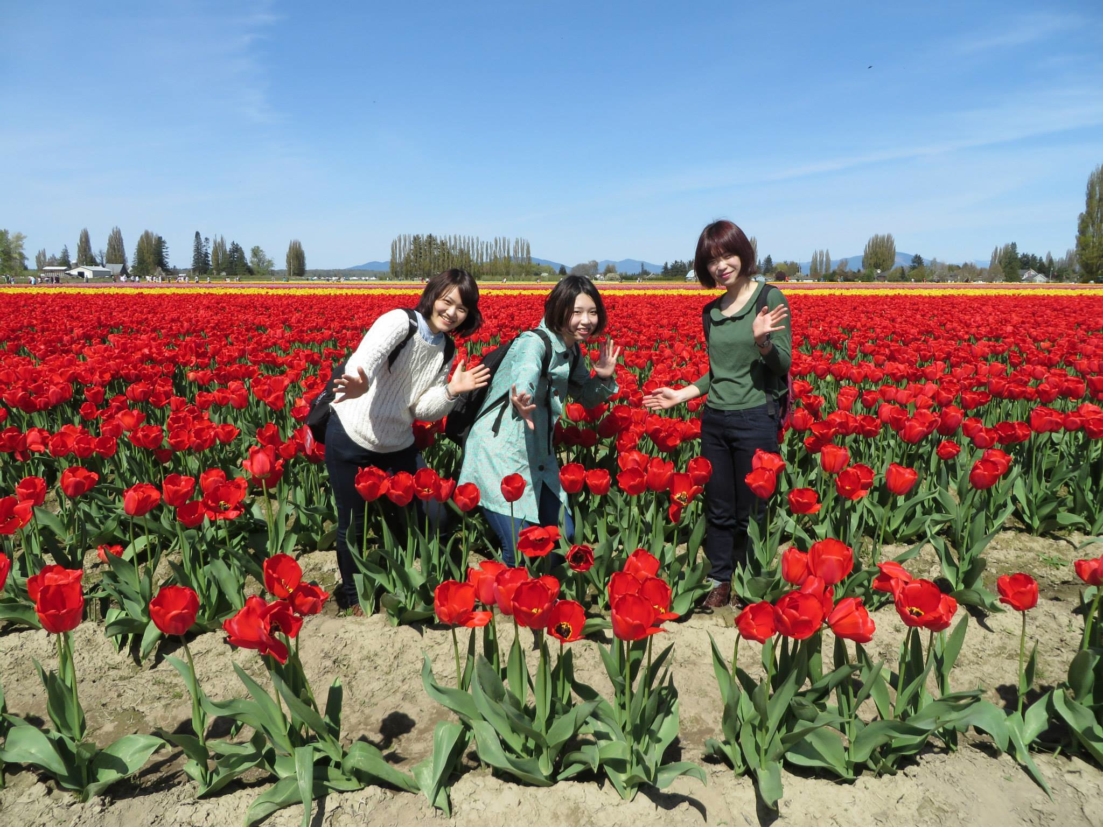
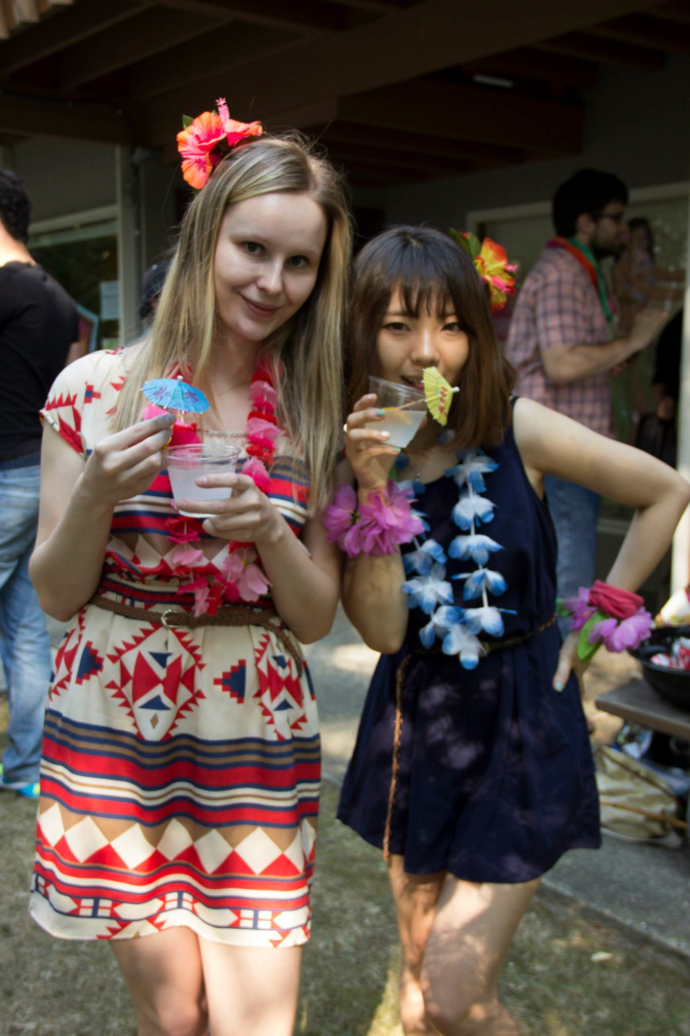
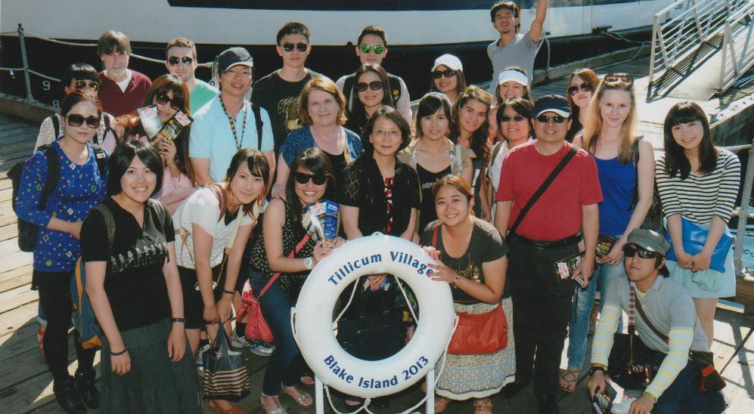
Student Life

Slide 28
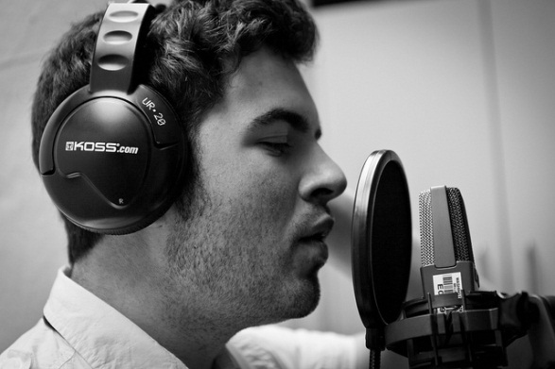
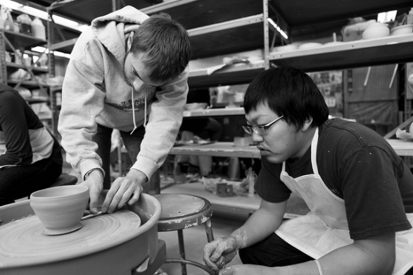
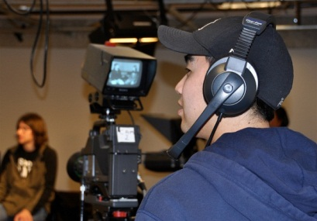
Student Life

Slide 29
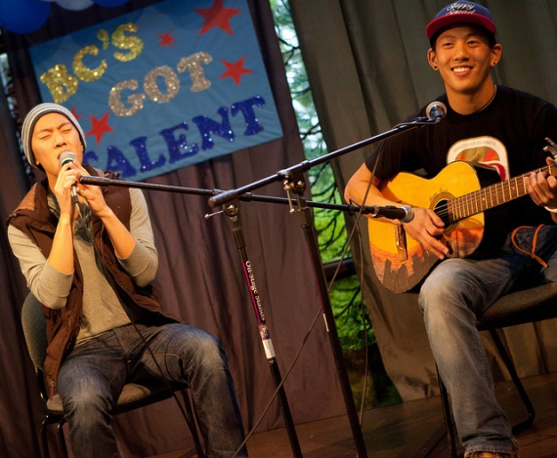
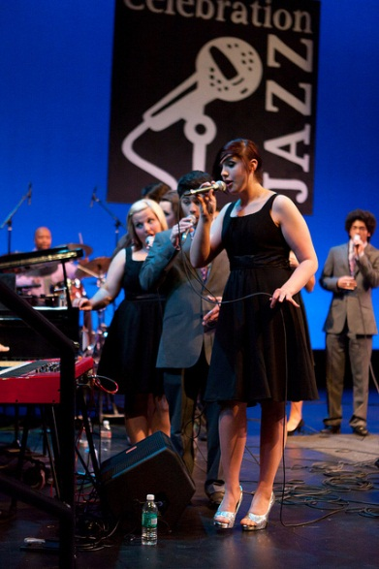
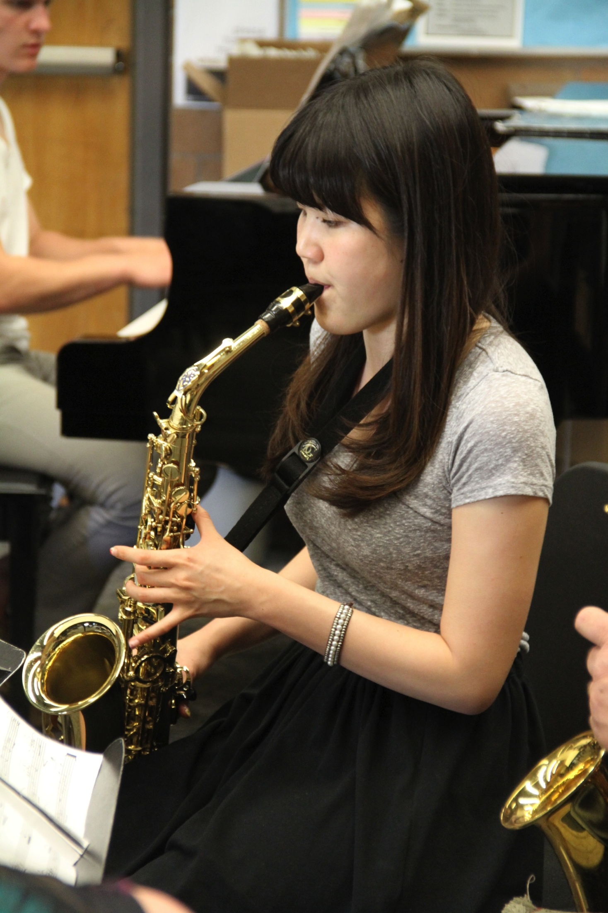
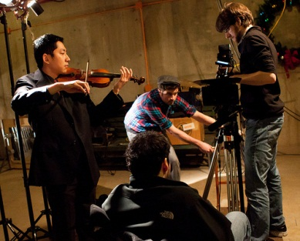
Student Life

Slide 30
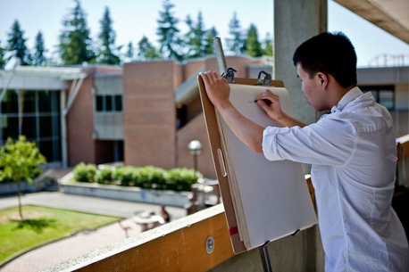
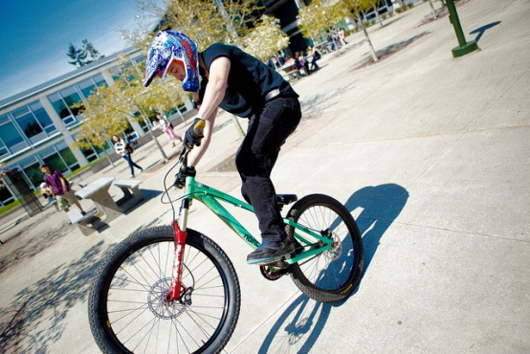
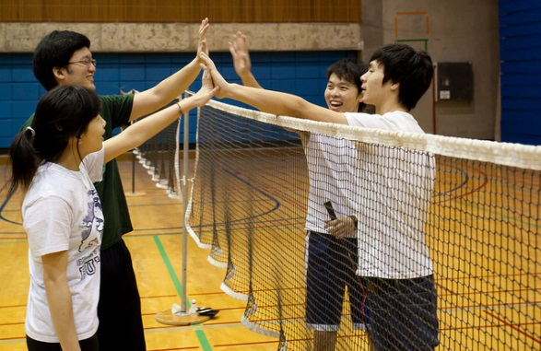
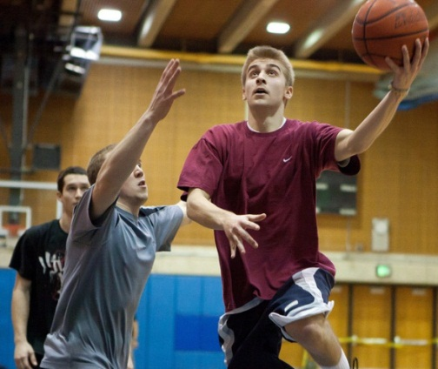
Extracurricular Activities

Slide 31
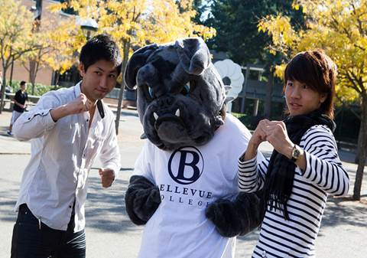
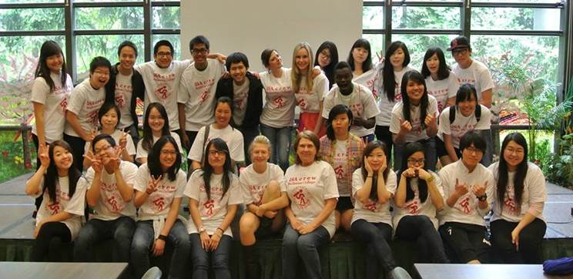
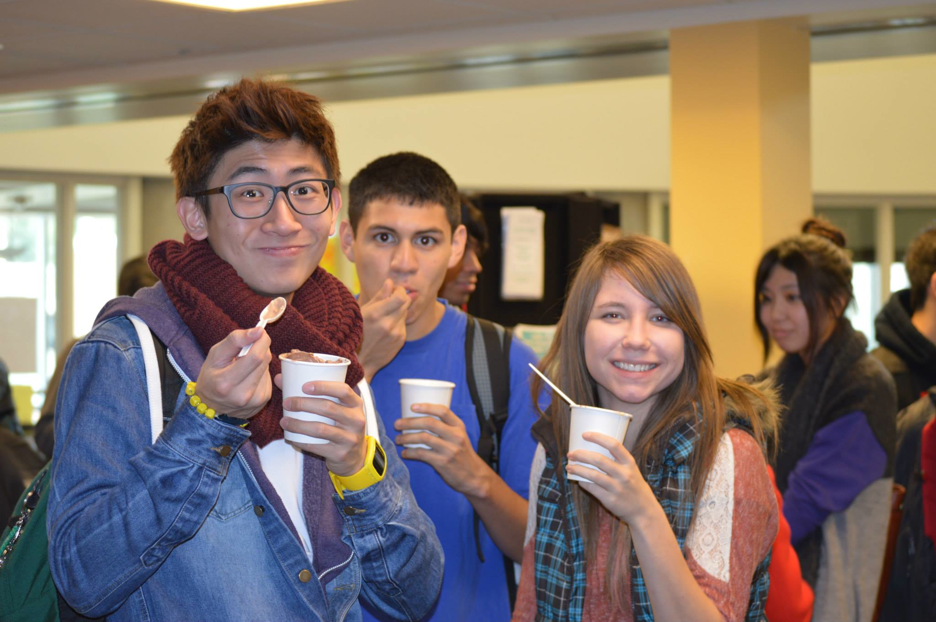
Life on Campus

Slide 32
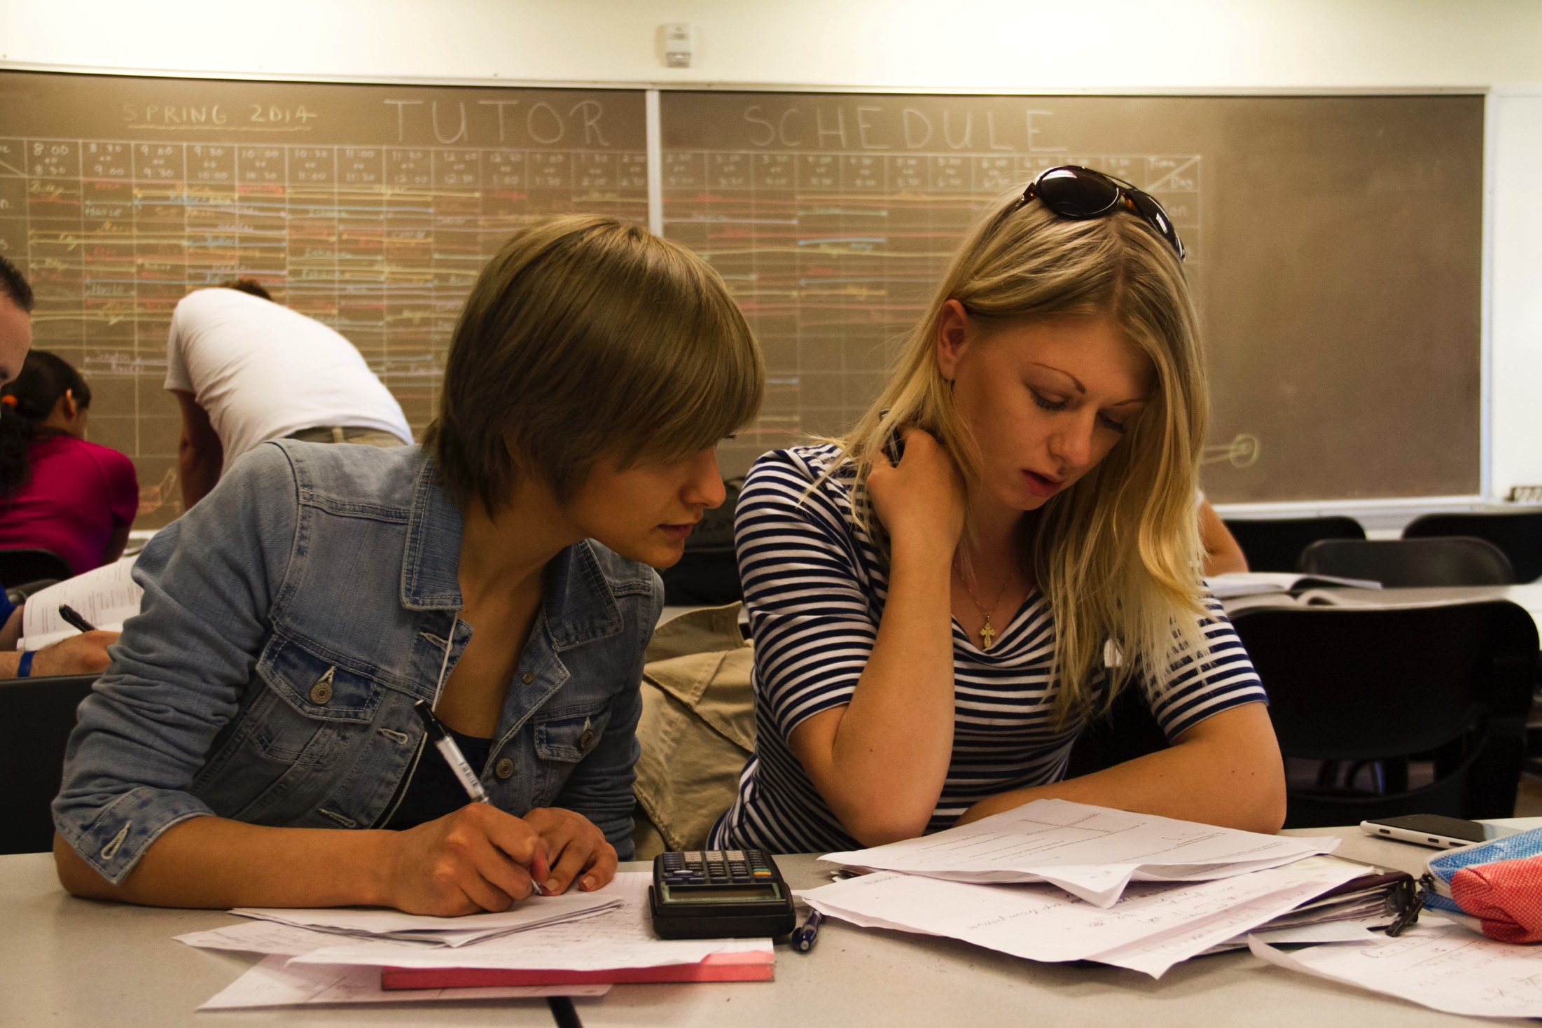
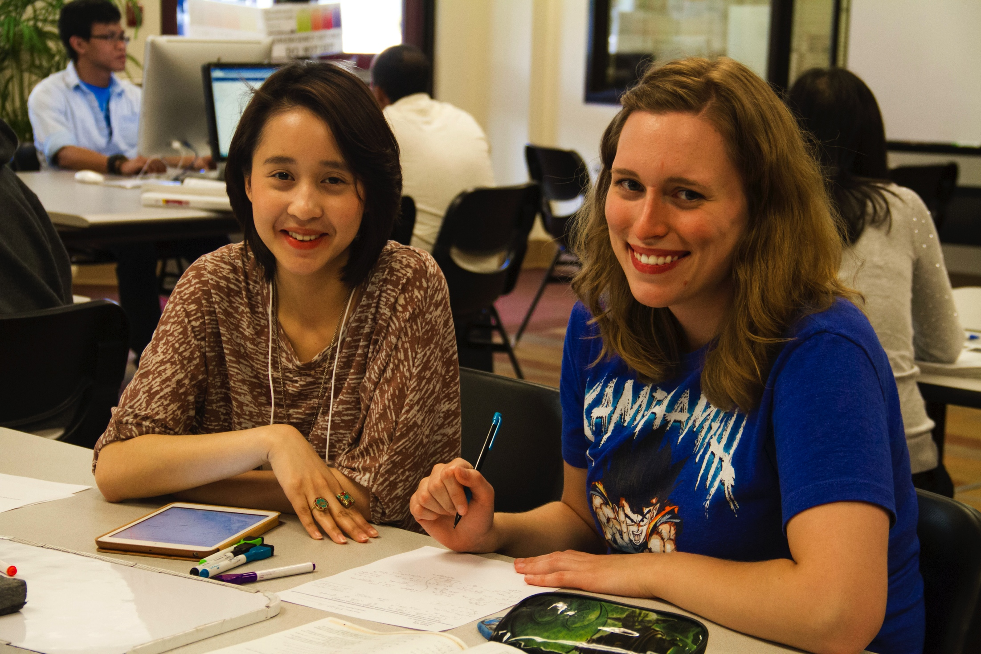
Life on Campus
Academic Support Services
-Writing and Reading Labs
-Math Labs
-Computer and Learning Labs
-Basic Skills Lab
-Library Media Center
-Science Study Center
-Academic Success Center

Slide 33
Bellevue College Athletics
Competitive:
Golf
Basketball
Volleyball
Soccer
Tennis
Track & Field
Baseball
Recreational:
Yoga
Dance
Aerobics
Open Gym

Slide 34
Seattle Seahawks

Slide 35
Guest Speakers
James Sinegal, Costco
Blake Nordstrom, Nordstrom

Slide 36
Student Testimony
“Aside from academic success, I am thankful for the many opportunities Bellevue College had given me to acquire many leadership experiences.
Thanks to my second family at Bellevue College, I am now able to continue my education in one of the most prestigious institutions.”
-Anh Nguyen, Vietnam
Anh is the first international student in Bellevue College’s history to be chosen as a commencement speaker. She is now attending Foster School of Business at the University of Washington with concentration in Finance & Marketing.

Slide 37
“I love Bellevue College because:
I’ve met and I have become friends with students from around the world.”
-Hyerim, Korea
“I love Bellevue College because:
Of the welcoming staff and instructors. They have enriched my knowledge and my life.”
-Juliana, Colombia
“I love Bellevue College because:
…it is a very safe, clean and peaceful studying environment….. I believe I can easily transfer to many high quality universities after Bellevue College.”
-Son, Vietnam

Slide 38
“I love Bellevue College because:
It’s perfect for me due to its safe environment, small classes and more student teacher interaction.”
-Bandar, Saudi Arabia
“I love Bellevue College because:
The online classes are great for self learners like me and the instructors are well prepared.”
-Stef, Brazil
“I love Bellevue College because:
It helps me to achieve my personal and academic goals , and I especially like the small class setting where I am pushed to speak more English.”
-Egemen, Turkey

Slide 39
“I love Bellevue College because:
Bellevue College has a great learning environment. The classes are small and people are friendly. Moreover, Bellevue College has helped me succeed in both my academic and personal life.”
-Suchada Anusuriya, Thailand
“I love Bellevue College because:
The school provides many opportunities for students to become leaders. “
-Kristianto, Indonesia
“I love Bellevue College because:
Of small class size, I get more attention from instructors, and it motivates me to work harder.”
-Grace, China

Slide 40
Where do Bellevue College International Students Transfer To …

Slide 41
Contact Us
International Student Programs
Bellevue College
3000 Landerholm Circle SE
Bellevue, WA 98007 USA
Email: isp@bellevuecollege.edu
Telephone: +1(425)564-3185

Slide 42
Thank You

