Slide 1
Strategy vs. Reaction
Strategy:
Focus on the foundation of the service catalog
Principle:
Users are at the center of all Information Resources does
Principle:
It is IR’s responsibility to empower users
Strategy:
Implement a personal network
Principle:
Everyone has access to IR services
Strategy:
Invest in tools that empower

Slide 2
Strategy vs. Reaction
The BC Private Cloud
Interaction Layer
Support Services
Application Services
Communication Services
Information Layer
Unified data services
Business intelligence architecture
Enterprise data architecture
Infrastructure Layer
Virtual Server Layer
Storage Layer
Network Layer
THE FOUNDATION FROM WHICH ALL WILL BE BUILT

Slide 3
Reaction
We just kept having to add stuff……….

Slide 4
Reaction
We have been very creative….

Slide 5
Strategy
Just getting started
Infrastructure Layer
Virtual Server Layer
Storage Layer
Network Layer
Just getting started
Investment made in production

Slide 6
Strategy
Pending
Just getting started
Information Layer
Unified data services
Business intelligence architecture
Enterprise data architecture
Just getting started

Slide 7
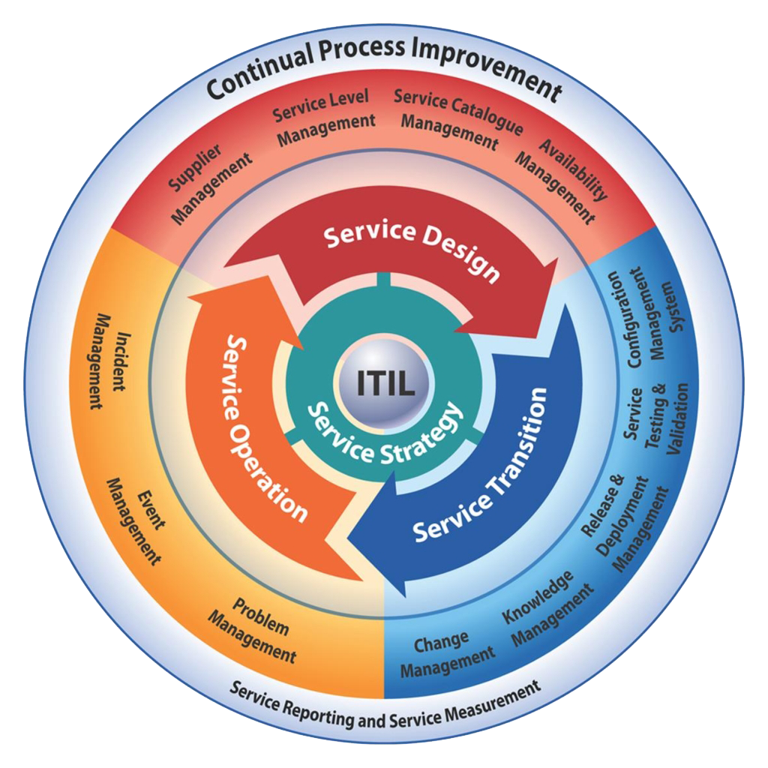
Strategy
Pending
Interaction Layer
Support Services
Application Services
Communication Services
Just getting started
Well under way

Slide 8
The Result
From This…..
To this…..

Slide 9
Discussion

